Slide 1
UNIT III – OpenFlow, Programmability and the Management Interface
UNIT I – SESSION 1
SESSION 3
Example: Controller Programming Flow Table
Example: Basic Packet Forwarding,
Example: Switch Forwarding Packet to Controller
OpenFlow 1.3 Additions
OpenFlow Limitations
Reference: Ref. 1, Ch.5.3.6 to Ch. 5.3.8
Ref. 1, Ch.5.6, 5.7

Slide 2
Example: Controller Programming Flow Table
We see in the figure that the initial flow table has three flows.
In the quiescent state before time ta, we see flow entry zero.
It shows that the flow entry specifies that all Ethernet frames entering the switch on input port K with a destination Ethernet address of 0x000CF15698AD should be output on output port N.
All other match fields have been wildcarded, indicated by the asterisks in their respective match fields in Figure.
At time ta, the controller sends a FLOW_MOD (ADD) command to the switch, adding a flow for packets entering the switch on any port, with source IP addresses 192.168.1.1 and destination IP address 209.1.2.1, source TCP port 20, and destination port 20. All other match fields have been wildcarded.
The outport port is specified as P. We see that after this controller command is received and processed by the switch, the flow table contains a new flow entry F corresponding to that ADD message.

Slide 3
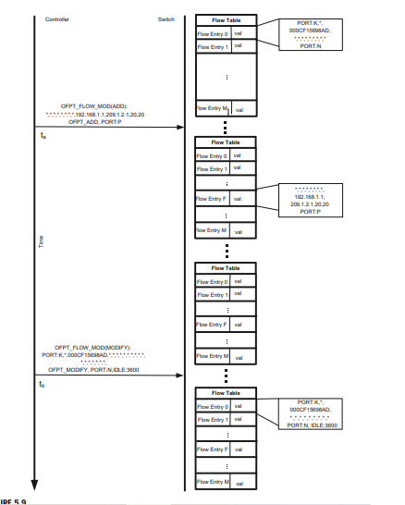

Slide 4
At time tb, the controller sends a FLOW_MOD (MODIFY) command for flow entry zero.
The controller seeks to modify the corresponding flow entry such that there is a one-hour (3600-second) idle time on that flow.
The figure shows that after the switch has processed this command, the original flow entry has been modified to reflect that new idle time.
Note that idle time for a flow entry means that after that number of seconds of inactivity on that flow, the flow should be deleted by the switch.
This controller had requested to be notified of such expiration when the flow was configured, and the FLOW_REMOVED messages serves this purpose.

Slide 5
Example: Basic Packet Forwarding
The packet arriving at the switch through port 2 with source IPv4 address of 192.168.1.1 and destination IPv4 address of 209.1.2.1.
The packet-matching function scans the flow table starting at flow entry 0 and finds a match in flow entry F.
Flow entry F stipulates that a matching packet should be forwarded out port P.
The switch does this, completing this simple forwarding example. An OpenFlow switch forwards packets based on the header fields it matches.
The network programmer designates layer three switch behavior by programming the flow entries to try to match layer three headers such as IPv4.
If it is a layer two switch, the flow entries will dictate matching on layer two headers.
The semantics of the flow entries allow matching for a wide variety of protocol headers but a given switch will be programmed only for those that correspond to the role it plays in packet forwarding.

Slide 6
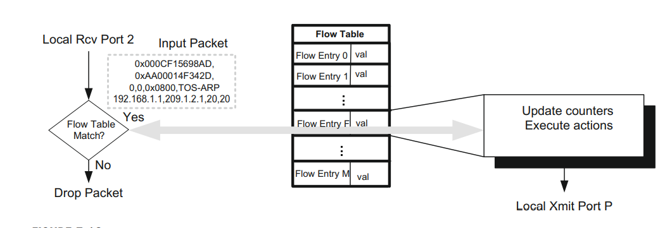
Example: Basic Packet Forwarding
Whenever there is overlap in potential matches of flows, the priority the controller assigns the flow entry will determine which match takes precedence.
For example, if a switch is both a layer two and a layer three switch, placing layer three header-matching flow entries at a higher priority would ensure that if possible, layer three switching will be done on that packet.

Slide 7
Example: Switch Forwarding Packet to Controller
Another fundamental action of the OpenFlow V.1.0 switch is to forward packets to the controller for exception handling.
The two reasons for which the switch may forward a packet to the controller are OFPR_NO_MATCH and OFPR_ACTION.
Obviously OFPR_NO_MATCH is used when no matching flow entry is found.
OpenFlow retains the ability to specify that a particular matching flow entry should always be forwarded to the controller.
In this case OFPR_ACTION is specified as the reason. An example is a control packet such as a routing protocol packet that always needs to be processed by the controller.
In Figure we show an example of an incoming data packet that is an OSPF routing packet.

Slide 8
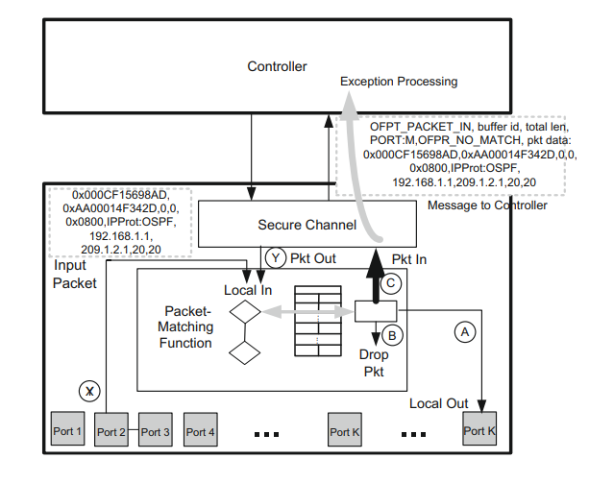

Slide 9
There is a matching table entry for this packet that specifies that the packet should be forwarded to the controller.
We see in the figure that a PACKET_IN message is sent via the secure channel to the controller, handing off this routing protocol update to the controller for exception processing.
The processing that would likely take place on the controller is that the OSPF routing protocol would be run, potentially resulting in a change to the forwarding tables in the switch.
The controller could then modify the forwarding tables via the brute-force approach of sending FLOW_MOD commands to the switch modifying the output port for each flow in the switch affected by this routing table change.
At a minimum, the controller needs access to the packet header fields to determine its disposition of the packet.
In many cases, though not all, it may need access to the entire packet.

Slide 10
In the event of a large number of packets being forwarded from the switch to the controller, for which the controller only needs to examine the packet header, significant bandwidth efficiency gains are achieved by buffering the full packet in the switch and only forwarding the header fields.
Since the controller will sometimes need to see the balance of the packet, a buffer ID is communicated with the PACKET_IN message.
The controller may use this buffer ID to subsequently retrieve the full packet from the switch.
The switch has the ability to age out old buffers that the switch has not retrieved.
There are other fundamental actions that the switch may take on an incoming packet:
  to flood the packet out all ports except the port on which it arrived, or
  to drop the packet.

Slide 11
OpenFlow 1.3 Additions
OpenFlow V.1.3 was released on April 13, 2012.
Many implementations are being based on V.1.3 in order to stabilize controllers around a single version.
For example, the iterative matching actions are difficult to implement in hardware at line rates. It is likely that the real-life chips that support V.1.3 will have to limit the number of flow tables to a manageable number.
Such limitations are not imposed on software-only implementations of OpenFlow, and, indeed, such implementations will provide full V.1.3 support.
The major new features added in this release are Refactor Capabilities Negotiation, More Flexible Table-Miss Support, Per-Flow Meters, Per Connection Event Filtering, Auxiliary Connections, Cookies in PACKET_IN, Provider Backbone Bridging Tagging.

Slide 12
Refactor Capabilities Negotiation
There is a new MULTIPART_REQUEST/MULTIPART_REPLY message pair in V.1.3.
Rather than having this capability information embedded as though it were a table statistic, the new message request-reply pair is utilized and the information is conveyed using a standard type-length-value (TLV) format.
Some of the capabilities that can be reported in this new manner include next-table, table-miss flow entry, and experimenter.
This new MULTIPART_REQUEST/REPLY message pair subsumes the older STATS_REQUEST/REPLY pair and is now used for both reporting of statistics and capability information.
The data formats for the capabilities are the TLV format, and this capability information has been removed from the table statistics structure

Slide 13
More Flexible Table-Miss Support
A table miss occurs when a packet does not match any flow entries in the current flow table in the pipeline. Formerly there were three configurable options for handling such a table miss. This included dropping the packet, forwarding it to the controller, or continuing packet matching at the next flow table.
V.1.3 expands on this limited handling capability via the introduction of the table-miss flow entry.
The controller programs a table-miss flow entry into a switch in much the same way it would program a normal flow entry.
The table-miss flow entry is distinct in that it is by definition of lowest priority (zero) and all match fields are wildcards.
The zero-priority characteristic guarantees that it is the last flow entry that can be matched in the table.
The fact that all match fields are wildcards means that any packet being matched against the table miss will be a match.

Slide 14
More Flexible Table-Miss Support
The upshot of these characteristics is that the table-miss entry serves as a kind of backstop for any packets that would otherwise have found no matches.
The advantage of this approach is that the full semantics of the V.1.3 flow entry, including instructions and actions, may be applied to the case of a table miss.
This capability adds more freedom to the matching “language” embodied by the flow tables, entries, and associated instructions and actions.

Slide 15
Per-Flow Meters
V.1.3 introduces a flexible meter framework. Meters are defined on a per-flow basis and reside in a meter table.
A given meter is identified by its meter ID. V.1.3 instructions may direct packets to a meter identified by its meter ID.
The framework is designed to be extensible to support the definition of complex meters in future OpenFlow versions. Such future support may include color-aware meters that will provide DiffServ QoS capabilities.
V.1.3 meters are only rate-limiting meters. As we see in Figure, there may be multiple meter bands attached to a given meter. Meter 3 in the example in the figure has three meter bands.
Each meter band has a configured bandwidth rate and a type. Note that the units of bandwidth are not specified by OpenFlow.
The type determines the action to take when that meter band is processed. When a packet is processed by a meter, at most one band is used.

Slide 16
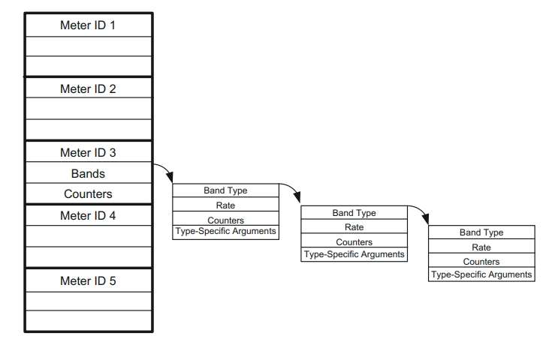
Per-Flow Meters

Slide 17
Per-Flow Meters
This band is selected based on the highest bandwidth rate band that is lower than the current measured bandwidth for that flow.
If the current measured rate is lower than all bands, no band is selected and no action is taken.
If a band is selected, the action taken is that prescribed by the band’s type field.
There are no required types in V.1.3. The optional types described in V.1.3 consist of DROP and DSCP remark.
DSCP remark indicates that the DiffServ drop precedence field of the Differentiated Services Code Point (DSCP) field should be decremented, increasing the likelihood that this packet will be dropped in the event of queue congestion.
Well-known and simple rate-limiting algorithms such as the leaky bucket may be implemented in a straightforward manner under this framework.
This feature provides direct QoS control at the flow level to the OpenFlow controller by careful programming of the meters.

Slide 18
Per-Flow Meters
As shown in Figure, there are meter-level counters and meter-band-level counters.
The meter counters are updated for all packets processed by the meter, and the per-meter-band counters are updated only when that particular band is selected.
The dual level of counters is key in that presumably the majority of the packets processed by the meter suffer no enforcement, but their passage through the meter must be recorded in order to track the current measured rate.

Slide 19
Per Connection Event Filtering
Multiple controllers, able to take on different roles, achieve an improved level of fault tolerance and load balancing.
The switches would only provide replies to the controller that initiated the request that elicits that reply.
V.1.3 introduces a SET_ASYNC message that allows the controller to specify the sorts of async messages it is willing to receive from a switch. It additionally allows the controller to filter out certain reason codes that it does not want to receive.
A controller may use two different filters: one for the master/equal role and another for the slave role.
This filter capability exists in addition to the ability to enable or disable asynchronous messages on a per-flow basis. This new capability is controller-oriented rather than flow-oriented.

Slide 20
Auxiliary Connections
V.1.3 introduces an additional layer of parallelism by allowing multiple connections per communications channel. That is, between a single controller and switch, multiple connections may exist.
The advantage provided by the additional connections on a channel lies in achieving greater overall throughput between the switch and the controller.
Because of the flow-control characteristics of a TCP connection, it is possible for the connection to be forced to quiesce (due to TCP window closing or packet loss) when there is actually bandwidth available on the physical path(s) between the switch and controller.

Slide 21
Auxiliary Connections
The first connection in the channel is specified to be a TCP connection.
The specification indicates that other, unreliable connection types, such as UDP, may be used for the secondary connections, but the specification is fairly clear that the problems of potential data loss and sequencing errors that can arise from the use of such alternative transport layers is beyond the scope of the specification.
If bandwidth between the controller and switch becomes a constraint, it is most likely due to a preponderance of data packets.
Some loss of data packets can be tolerated. Thus, the primary intended use of the auxiliary connections is to transmit and receive data packets between the switch and the controller.
This presumes that any control messages would be sent over the reliable, primary connection.

Slide 22
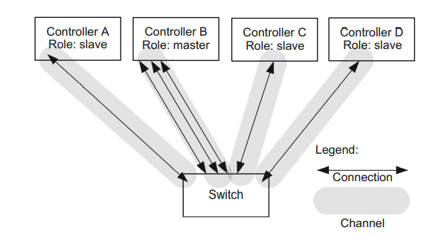
One example of the utility of auxiliary connections is that when a switch has many PACKET_IN messages to send to the controller, this can create a bottleneck due to congestion.
The delay due to this bottleneck could prevent important OpenFlow control messages, such as a BARRIER_REPLY message, from reaching the controller.
Sending PACKET_IN data messages on the UDP auxiliary connection will obviate this situation.
Another possible extension to this idea is that the OpenFlow pipeline could send UDP-based PACKET_IN messages directly from the ASIC to the controller without burdening the control code on the switch CPU.

Slide 23
Cookies in PACKET_IN
This cookie allows the switch to cache the flow entry pointed to by this cookie and circumvent the full packet-matching logic.
Such a cookie would not provide any efficiency gain the first time it is sent by the switch for this flow, but once the controller caches the cookie and pointer to the related flow entry, considerable performance boost can be achieved.
The actual savings accrued would be measured by comparing the computational cost of full packet-header matching versus performing a hash on the cookie.
The switch maintains the cookie in a new field in the flow entry.
The priority field determines where this particular flow entry is placed in the table. A higher priority places the entry lower in the table such that it will be matched before a lower-priority entry.

Slide 24
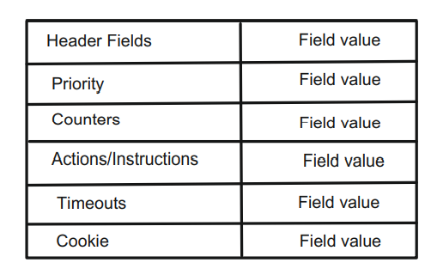
V1.3 Flow Entry
The timeouts field can be used to maintain two timeout clocks for this flow. Both an idle timer and a hard timeout may be set.
If the controller wants the flow to be removed after a specified amount of time without matching any packets, then the idle timer is used.
If the controller wants the flow to exist only for a certain amount of time, regardless of the amount of traffic, the hard timeout is used and the switch will delete this flow automatically when the timeout expires.

Slide 25
Provider Backbone Bridging Tagging
Earlier versions of OpenFlow supported both VLAN and MPLS tagging.
Another WAN/LAN technology known as provider backbone bridging (PBB) is also based on tags similar to VLAN and MPLS.
PBB allows user LANs to be layer two bridged across provider domains, allowing complete domain separation between the user layer two domain and the provider domain via the use of MAC-in-MAC encapsulation.
This is a useful technology that’s already supported by high-end commercial switches; support for this in OpenFlow falls out easily as an extension to the support already provided for VLAN tags and MPLS shim headers

Slide 26
OpenFlow Limitations
One limitation is that the currently defined match fields are limited to the packet header.
Thus, deep packet inspection (DPI), whereby fields in the packet’s payload may be used to distinguish flows, is not supported in a standard OpenFlow.
Nonetheless, the EXPERIMENTER modes that are permitted within OpenFlow do open the way for such application layer flow definition in the future.
Second, some OpenFlow abstractions may be too complex to implement directly in today’s silicon.
This is unlikely to remain an insurmountable obstacle for long, however, since the tremendous momentum behind SDN is likely to give birth to switching chips that are designed explicitly to implement even OpenFlow’s most complicated features.

